Slide 1

New Store Front Design
Final Exam
Course: CS 390
Team_22
Team Members: Jacob Cohen, Frank Calabrese, Matthew Younker

Slide 2
Table of Contents
2
Part I: Introduction and Market Analysis
Top ten current store fronts ….......................................slide 4
Prevalent class objects …...............................................slide 5
Prevalent functions …....................................................slide 7
Project goal …................................................................slide 8
Customer Requirements …............................................slide 9
Process Model …...........................................................slide 10
Part II: Software Engineering Analysis Models
Class Objects diagram …...............................................slide 12
Context data flow diagram …........................................slide 13
Part III: Software Engineering Design Models
Architectural model ....................................................slide 16
Hierarchical model …...................................................slide 17
Part IV: Development Project Estimates & Recommendations
Project Estimates …....................................................slide 46
Recommendations …..................................................slide 47
Appendix A ….............................................................slide 48
Appendix B …............................................................slide 70

Slide 3

Part I: Introduction and Market Analysis
3

Slide 4
Market Analysis Top 10 Software store fronts
4
Steam - $4.3 billion
Epic Game Store - $931 million
Microsoft Store - $9.1 billion (Microsoft Gaming)
Battle.net - $2.29 billion
Apple App Store - $54.2 billion
Origin - $4.93 billion (EA)
Humble Bundle - $10-50 million
Google Play Store - $29.3 billion
GOG - $109.3 million
Uplay – $1.9 billion

Slide 5
10 Prevalent Class Objects
5
 | Steam | Epic | Microsoft Store | Battle.net | Apple App Store | Origin | Humble Bundle | Google Play | GOG | Uplay
Reviews | x |  | x |  | x |  |  | x | x
Friends Lists | x | x |  | x |  | x |  |  | x | x
Libraries | x | x | x |  | x | x | x | x | x | x
Wallets | x |  | x | x | x |  | x | x | x
Wish-lists | x | x | x | x |  | x | x | x | x
Forums | x |  |  |  |  |  |  |  | x
Mods | x | x
Accounts | x | x | x | x | x | x | x | x | x | x
Carts | x |  | x |  |  |  | x |  | x | x
Listings | x | x | x | x | x | x | x | x | x | x
Research data located in Appendix A

Slide 6
Class Object Consistency
6
Reviews | 5/10
Friends | 5/10
Libraries | 8/10
Wallets | 7/10
Wish-lists | 8/10
Forums | 2/10
Mods | 3/10
Accounts | 10/10
Carts | 4/10
Listings | 10/10
Less Than 50%
50% - 70%
More Than 80%
Research data located in Appendix A

Slide 7
10 Prevalent Functions
7
 | Steam | Epic | Microsoft Store | Battle.net | Apple App Store | Origin | Humble Bundle | Google Play | GOG | Uplay
Write Review | x |  | x |  | x |  |  | X | x
Buy Listing | x | x | x | x | x | x | x | x | x | x
View Library | x | x | x | x | x | x | x | x | x | x
Change Info | x | x | x | x | x | x | x | x | x | x
Add to Wishlist | x | x | x |  |  | x | x | x | x
Send Message | x |  |  | x |  | x |  |  | x | x
Add to Cart | x |  | x |  |  |  | x |  | x | x
Install Game | x | x | x | x | x | x | x | x | x | x
Purchases subscription |  |  | x |  |  | x | x | x |  | x
Redeem Codes | x | x | x | x | x | x |  | x | x | x
Research data located in Appendix A

Slide 8
Project Goal: A Storefront for Various Software Products
8

Slide 9
Customer Requirements (Summary)
Purpose
Provide consumers with a storefront that supplies and streamlines relevant functionality in a single package, rather than having customers rely on third-party sites or software
Benefits
Integration of complementary and relevant software into a new software storefront for customer convenience
Scope
Application-level software
Select system-level software
Game engines
IDEs
Main Functions
1. Purchase software
2. Review software
3. Discuss software
4. Retain library of owned software products
5. Track software development and updates
6. Streamline networking through friends list
7. Message users and developers
8. Purchase subscriptions
9. Redeem software through product codes
10. Install purchased software
11. Install unofficial patches
12. Vote for featured unofficial patches
13. Set GPU and CPU fan speeds
14. Allow auto control of fan speeds
Personal use
Professional
publishing

Slide 10
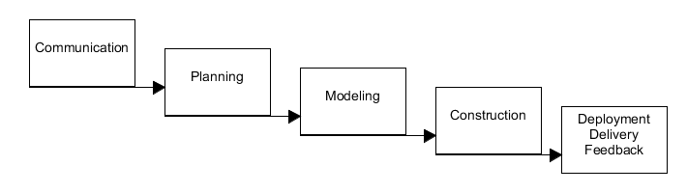
Prescriptive SE Process Model
Incremental Model
The software will need room to expand to include new functionality and features
The software will evolve gradually over time, not have generational new releases
Medium level human computer interaction
3rd incr.
2nd incr.
1st incr. (currently modelling)

Slide 11

Part II: SE Analysis Models developed
11

Slide 12
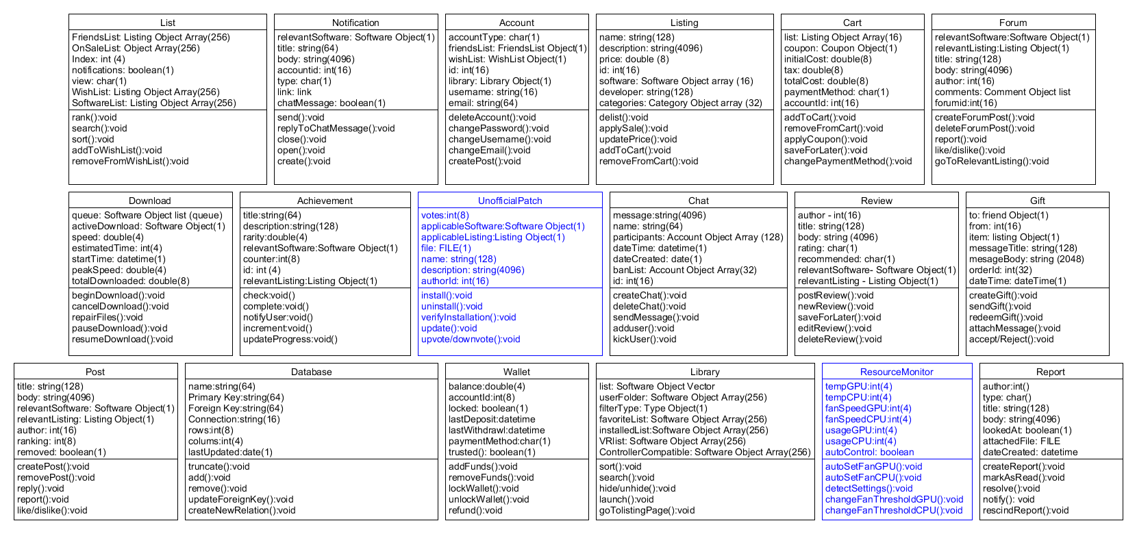
Class Objects Diagram
12

Slide 13
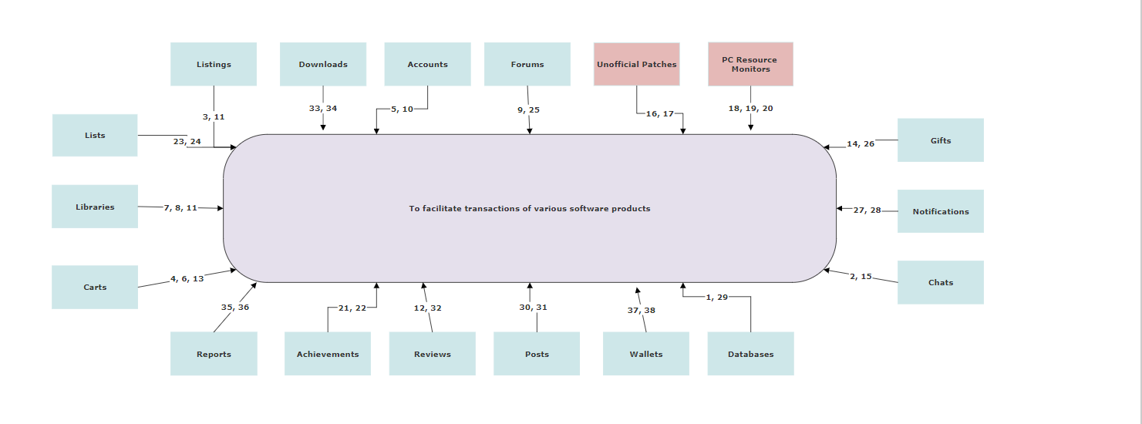
Context Data Flow Diagram
13

Slide 14
Context DFD Functions
14
1. Update Row
2. Send Message
3. Add to Cart
4. Checkout
5. Login / Logout
6. Apply Coupon
7. Activate Product
8. View Library
9. Like/Dislike Post
10. Delete Account
11. Install Software
12. Post Review
13. Redeem Code
14. Send Gift
15. Add to Chat
16. Submit Unofficial Patch
17. Vote for Unofficial Patch
18. Auto Detect Settings
19. Enable/Disable Monitor
20. Auto Fans
21. Unlock Achievement
22. Update Progress
23. Add to List
24. Remove from List
25. Create Post
26. Purchase Gift
27. Send Notification
28. Clear Notification
29. Remove Row
30. Comment on Post
31. Submit Post
32. Remove Review
33. Begin Download
34. Cancel Download
35. Create Report
36. Send Report
37. Add Funds
38. Lock Wallet

Slide 15

Part III: SE Design Models Developed
15

Slide 16
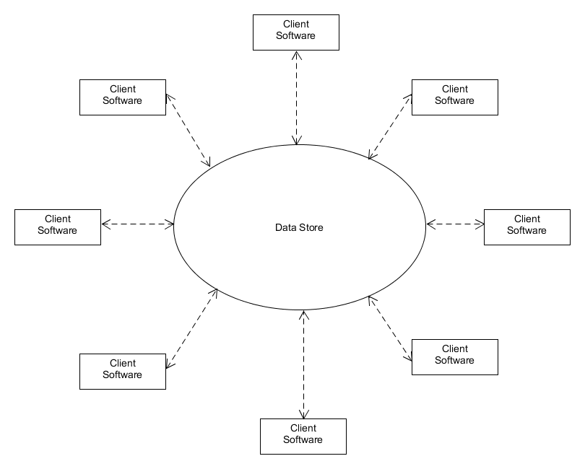
Architectural Model
16
Data Centered

Slide 17
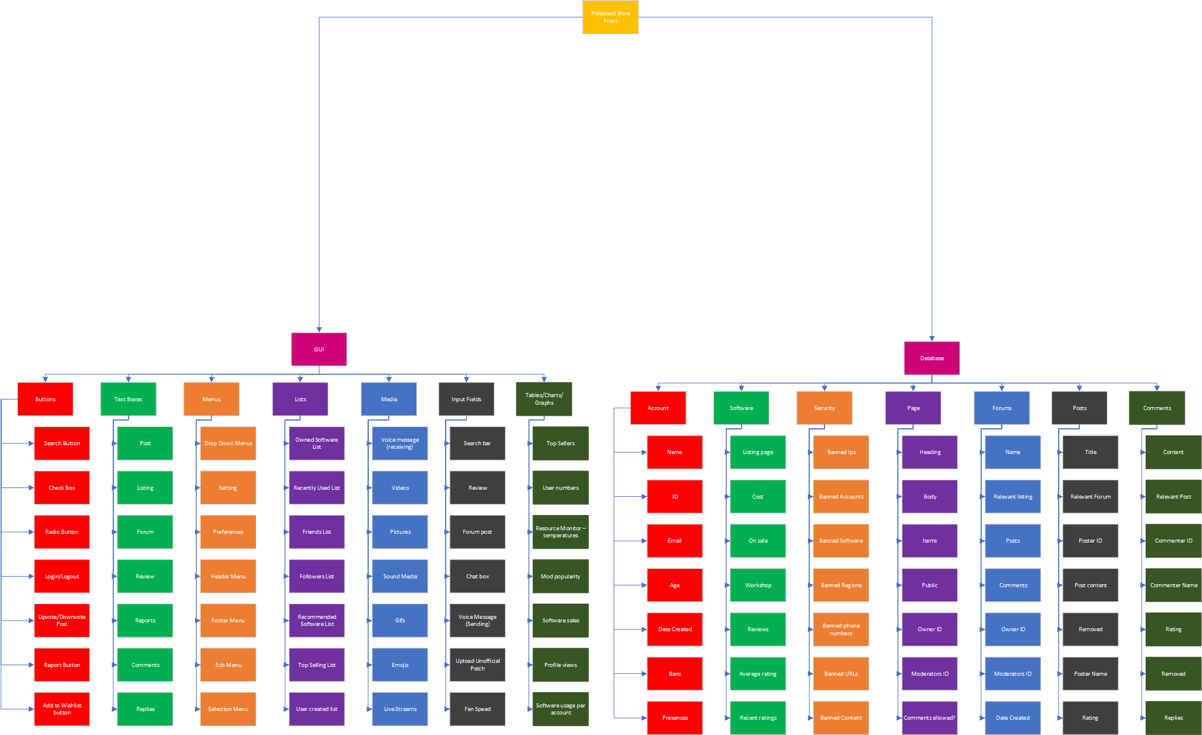
Hierarchical Design Model
17

Slide 18
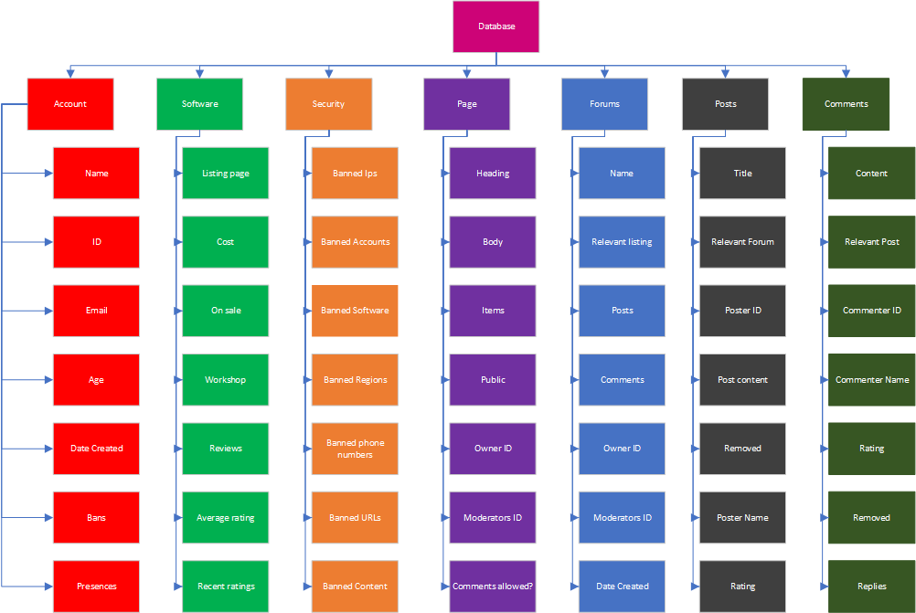
Hierarchical Design Model for Databases
18

Slide 19
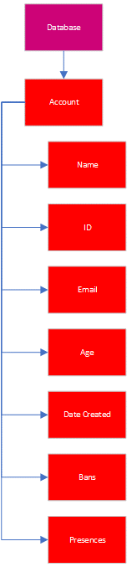
Hierarchical Design Model for Database Account View
19

Slide 20
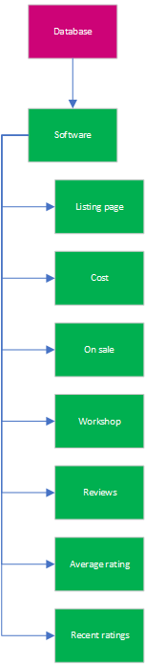
Hierarchical Design Model for Database Software View
20

Slide 21
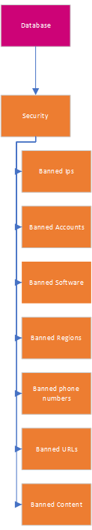
Hierarchical Design Model for Database Security View
21

Slide 22
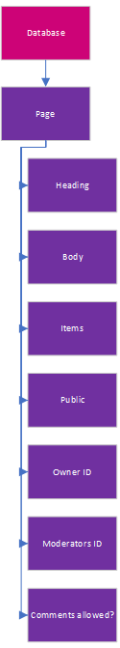
Hierarchical Design Model for Database Page View
22

Slide 23
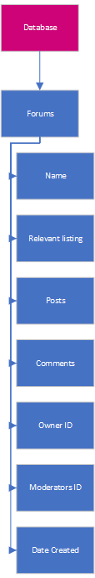
Hierarchical Design Model for Database Forums View
23

Slide 24
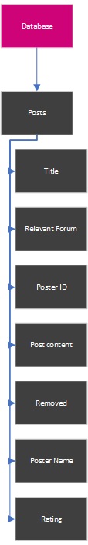
Hierarchical Design Model for Database Posts View
24

Slide 25
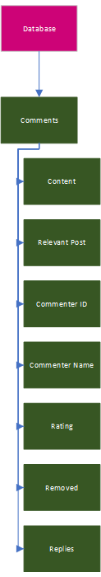
Hierarchical Design Model for Database Comments View
25

Slide 26
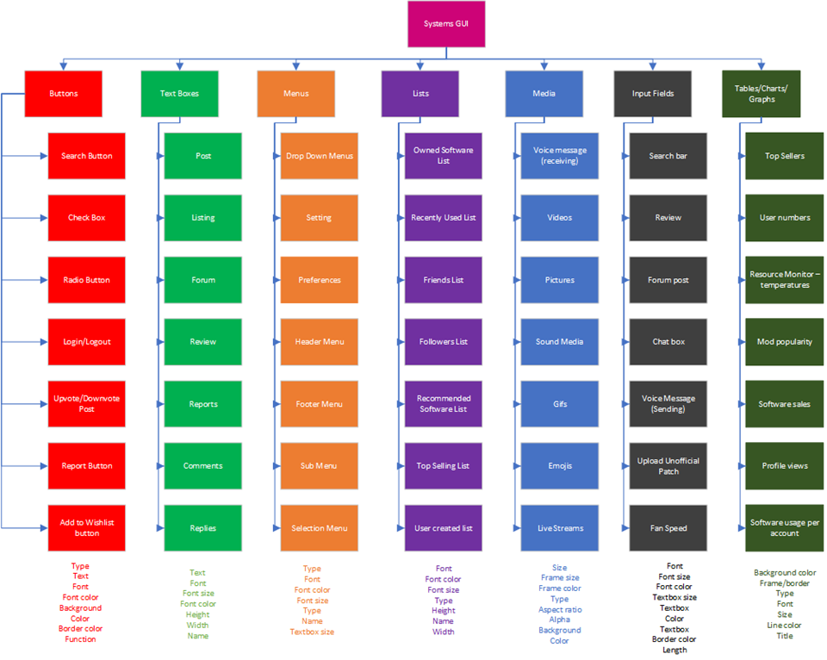
Hierarchical Design Model for GUI
26

Slide 27
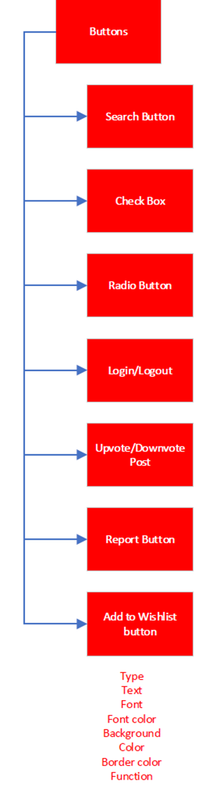
Hierarchical Design Model for GUI Buttons View
27

Slide 28
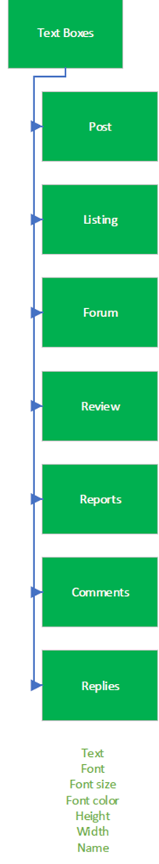
Hierarchical Design Model for GUI Text Boxes View
28

Slide 29
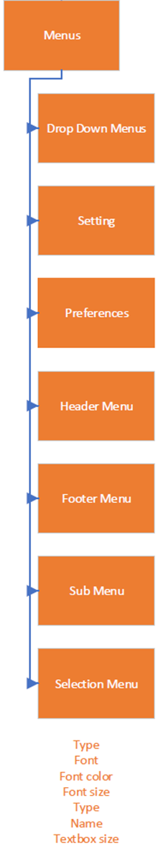
Hierarchical Design Model for GUI Menus View
29

Slide 30
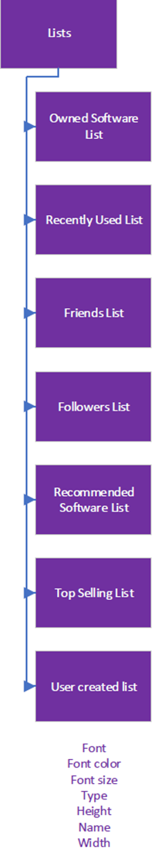
Hierarchical Design Model for GUI Lists View
30

Slide 31
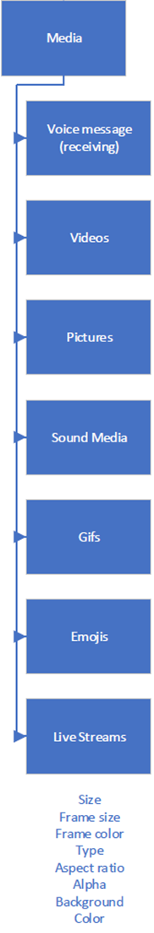
Hierarchical Design Model for GUI Media View
31

Slide 32
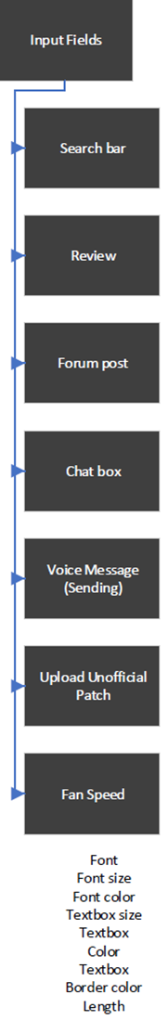
Hierarchical Design Model for GUI Input Fields View
32

Slide 33
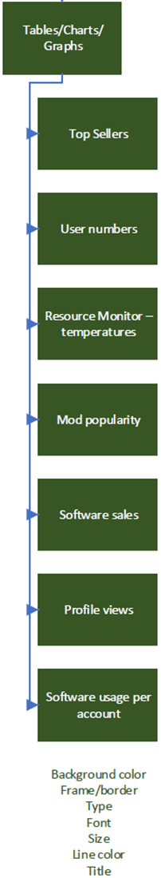
Hierarchical Design Model for GUI Tables, Charts, and Graphs View
33

Slide 34
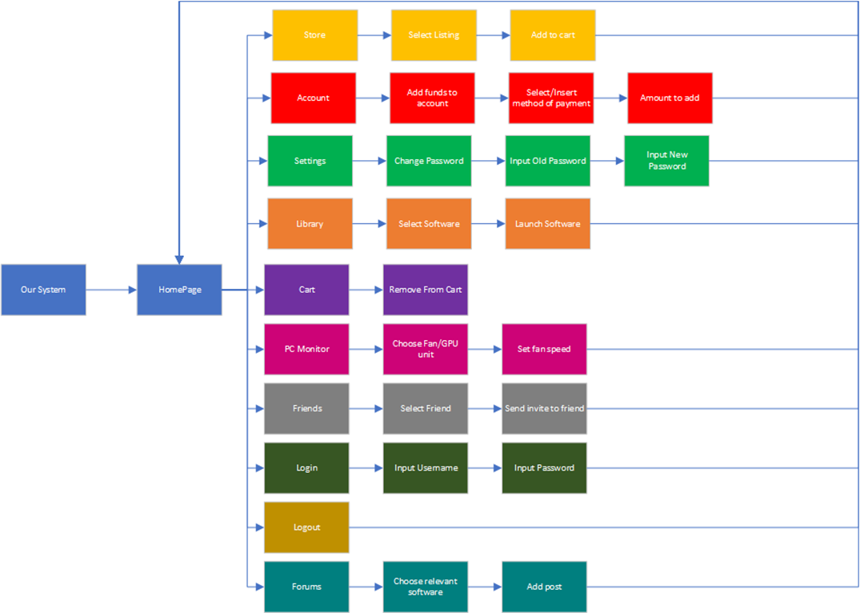
Hierarchical Design Model GUI Functions
34

Slide 35

GUI Hierarchical Design Model Functions
35
Store

Slide 36
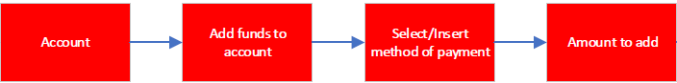
GUI Hierarchical Design Model Functions
36
Account

Slide 37
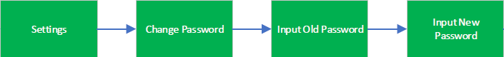
GUI Hierarchical Design Model Functions
37
Settings

Slide 38
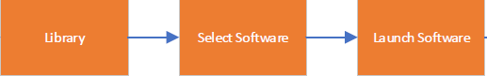
GUI Hierarchical Design Model Functions
38
Library

Slide 39
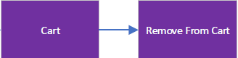
GUI Hierarchical Design Model Functions
39
Cart

Slide 40
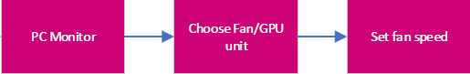
GUI Hierarchical Design Model Functions
40
PC Monitor

Slide 41
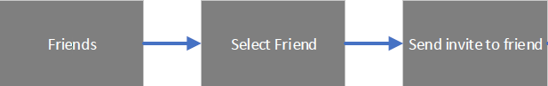
GUI Hierarchical Design Model Functions
41
Friends

Slide 42
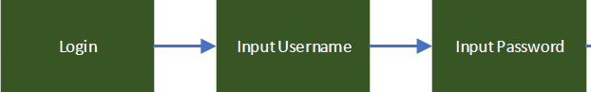
GUI Hierarchical Design Model Functions
42
Login

Slide 43
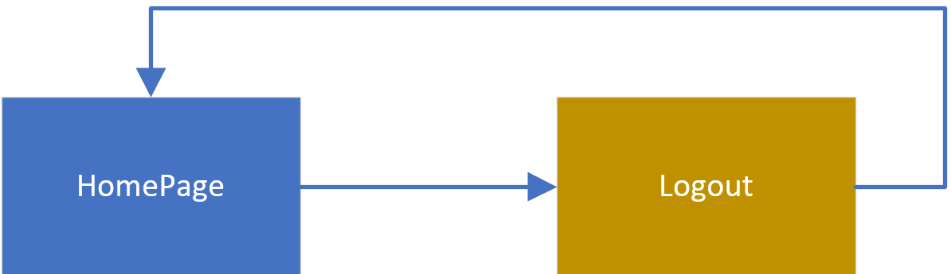
GUI Hierarchical Design Model Functions
43
Logout

Slide 44

GUI Hierarchical Design Model Functions
44
Forums

Slide 45

Part IV: SW Development Project Estimates and Project Team Recommendations
45

Slide 46
Software System Development Project Estimates
46
The Epic Games Store, the newest of the top 10 storefronts took about 2 years to get about 1/3 of their functionality shipped. With one large update in between. Based off this fact, main increments can be estimated to ship every 8-12 months.
After ~2 years Epic Games is still missing:
mod support
Achievements
trending filters
DLC discovery
news feed
Gifting
Reviews
Cart
and more

Slide 47
Recommendations
47
1. Proceed to the construction phase of the first
increment of the software development lifecycle.
2. Prepare a team to begin working on the
communication phase of the second increment of
the software. Allocate around $1 million for advising, construction, and licensing costs.
3. Continue developing incremental additions to the software according to the SDLC guidelines. Prepare to deploy a new main increment every 8-12 months. ~ 4,650 lines of exhaustively tested code per increment

Slide 48

Thank you for your time. Any Questions?
48

Slide 49
Appendix A: Market Analysis Sources
49

Slide 50


50
Class Objects
User Accounts
Developer Accounts/ Companies
Apps
Moderators/Editors
Update Lists
Libraries
Subscriptions
Posts
Reviews
In-App Purchases
Payment Methods
App/Song/etc. gifts
Apple ID credit gifts
Notifications
Updates
Functions
Create Account
Login/Logout
Purchase App
Delete App
Update App
Search Store
Redeem Code
Post Review
Share App
Buy Gift
Generate Recommendations
Send Receipts
https://apps.apple.com/us/app/apple-store/id375380948

Slide 51
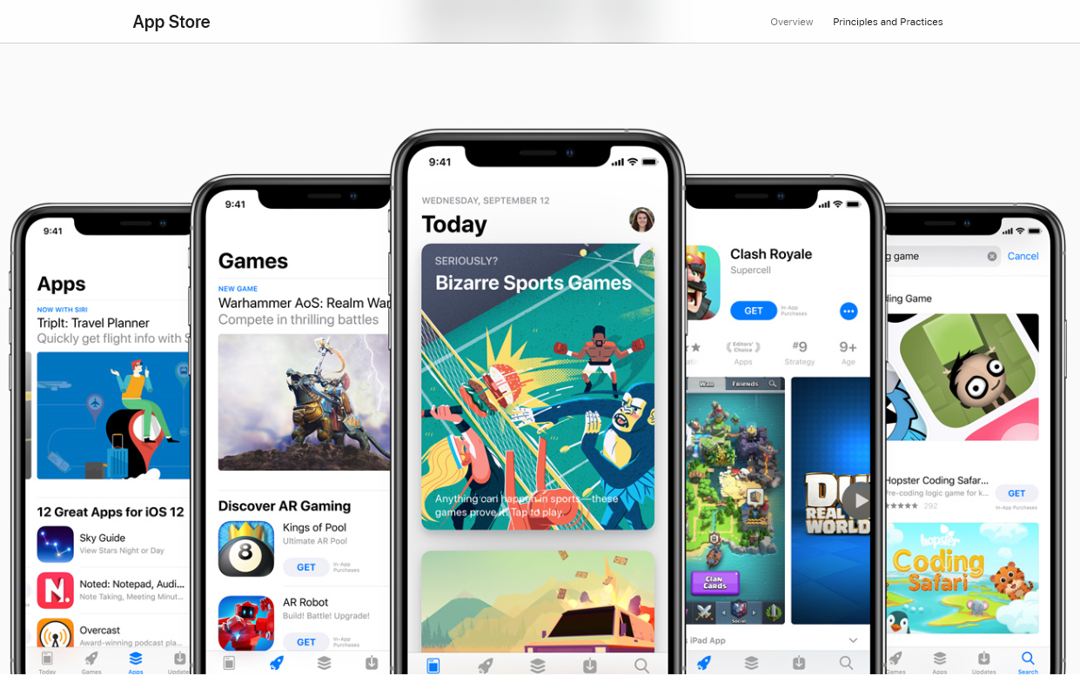
App Store Interface
51

Slide 52

52
Class Objects
User Accounts
Dev Accounts/ Companies
Apps
Movies/TV
Albums
Books
Devices
Carts
Wish-lists
Reviews
Subscriptions
Payment Methods
History Lists
Rewards
Play Points
Functions
Login/Logout
Make Purchase
Set budget
Post review
Update app
Send receipt
Search Store
Redeem code
Redeem reward
Buy gift card
Add to Wish-lists
Show recommended
Create Account
https://play.google.com/store

Slide 53
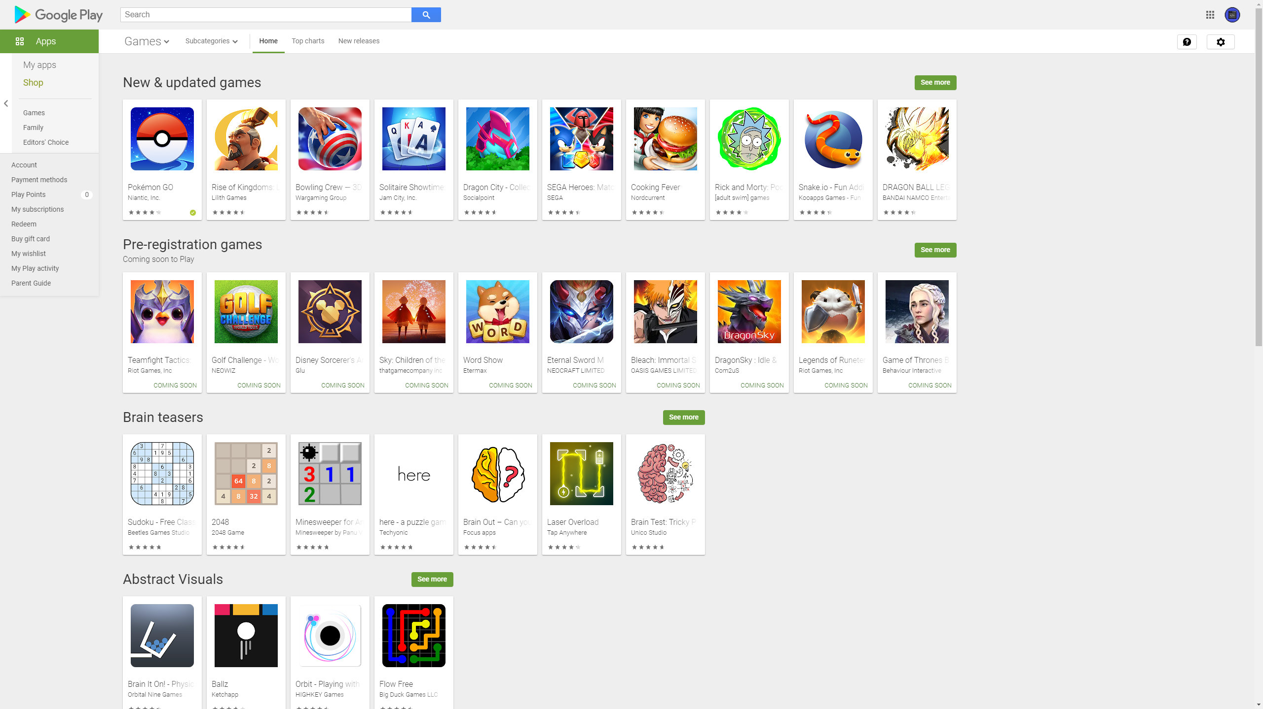
Google Play Interface
53

Slide 54

54
Class Objects
User Accounts
Dev Accounts/ Companies
Clubs
Games
Entertainment
Productivity
Wish-lists
Reviews
Feedback
Products
Apps
Wallets
DLC
System Requirements
Libraries
Functions
Login/Logout
Create Account
Give Feedback
Search Store
Add to Wishlist
Redeem code
Make Purchase
Give Recommendations
Post review
Give Gift
Share
Update app
Subscribe (game pass, etc.)
Change Account Info
https://www.microsoft.com/en-us/store/top-free/apps/pc

Slide 55
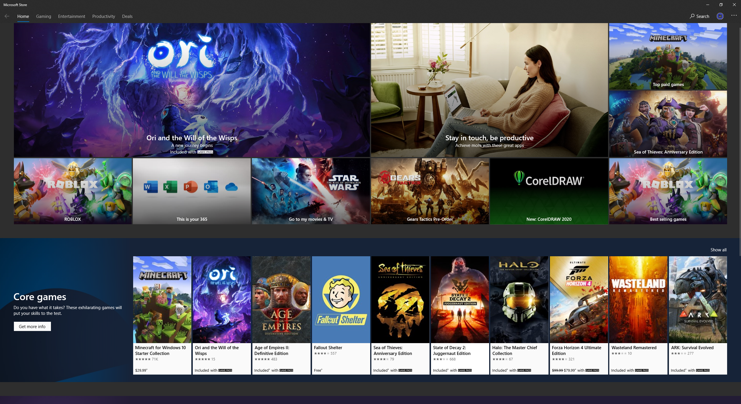
Windows Store Interface
55

Slide 56

Class Objects
Accounts
Messages
Software
Listings
Libraries
Orders
Friends
Wish-lists
Chats
Downloads
Categories
Posts
Keys
Points
Achievements
Functions
Login/Logout
Buy Listing
Install/uninstall software
Filter store/library
Add/remove from Wishlist
Send message
Run software
Add/remove friend
Remove notification
Edit Account info
https://www.origin.com/usa/en-us/store

Slide 57
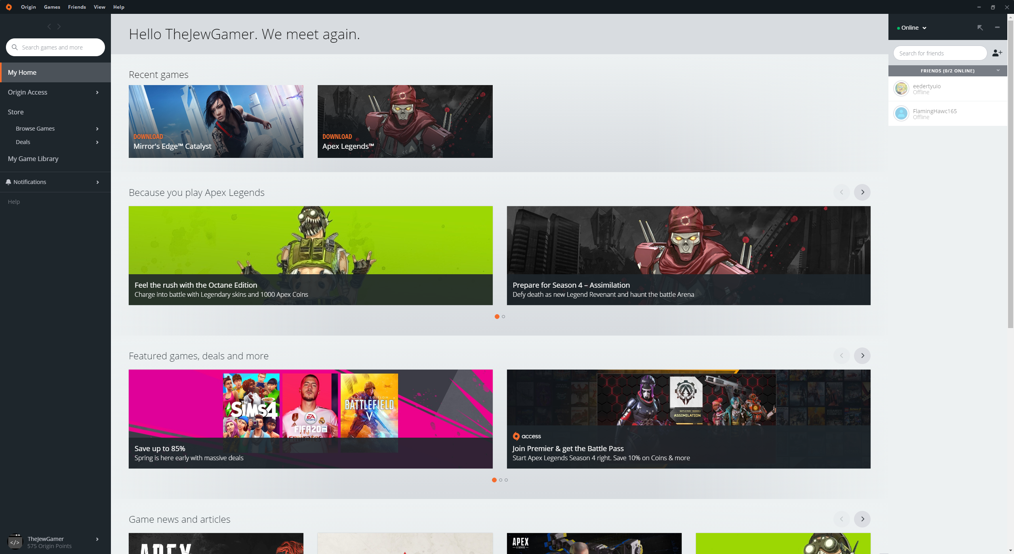
Origin Interface
57

Slide 58

58
Class Objects
Accounts
Friends
Chats
Approver
Broadcasts
Listings
Administrators
Coupons
Wish-lists
Carts
Libraries
Reviews
Mods
Forums
Profile Pages
Functions
Send Message
Login/Logout
Write Review
Create Workshop item
Add listing to marketplace
Buy game
Add to cart
Refund game
Sell on Marketplace
Add game to category
Join group
https://store.steampowered.com/

Slide 59
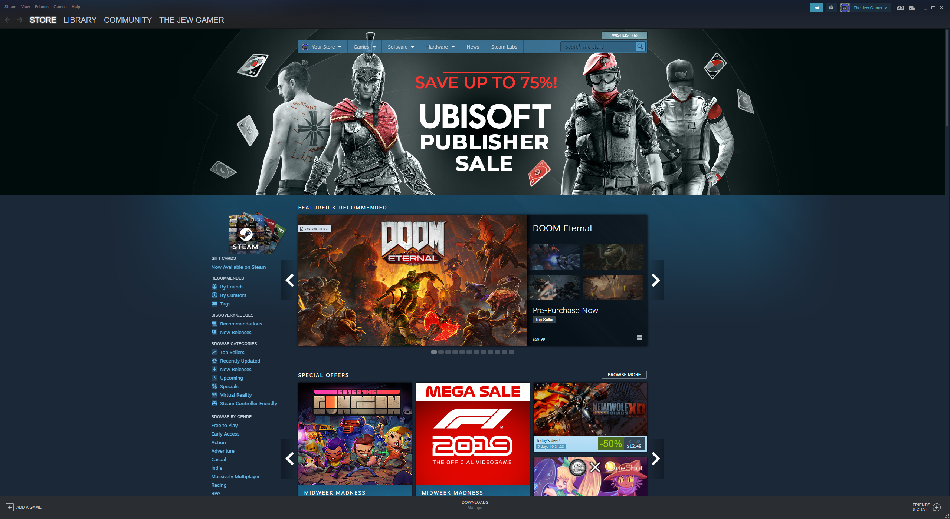
Steam Interface
59

Slide 60

60
Class Objects
Accounts
Listings
Friends
Chat Histories
Groups
Notifications
Wallets
Payment Methods
BattleTags
Software
DLC
Wish-lists
Gifts
Subscriptions
Posts
Functions
Add listing
Create account
Login/Logout
Purchase listing
Download
Play Game
Send friend request
Accept friend Request
Send chat
Write Post
https://www.blizzard.com/en-us/?ref=www.battle.net

Slide 61
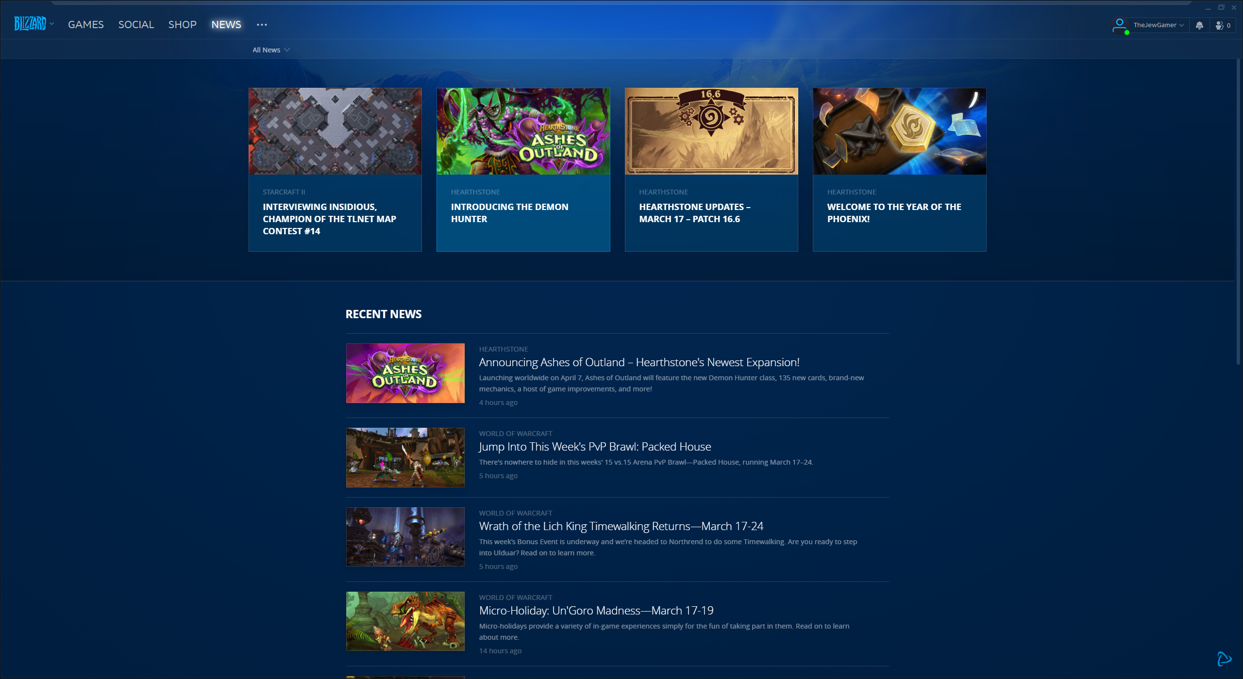
Battle.Net Interface

Slide 62

Class Objects
Accounts
Software
Carts
Friends
Chats
DLC
Listings
Achievements
Payment Methods
Coupons
Posts
Keys
Libraries
Club Points
Subscriptions
Functions
Add/Remove from cart
Add/remove friend
Send Message
Checkout
Install/Uninstall software
Spend micro-currency
Link Steam Account
Search
Filter Store
Login/Logout
https://uplay.ubisoft.com/en-GB

Slide 63
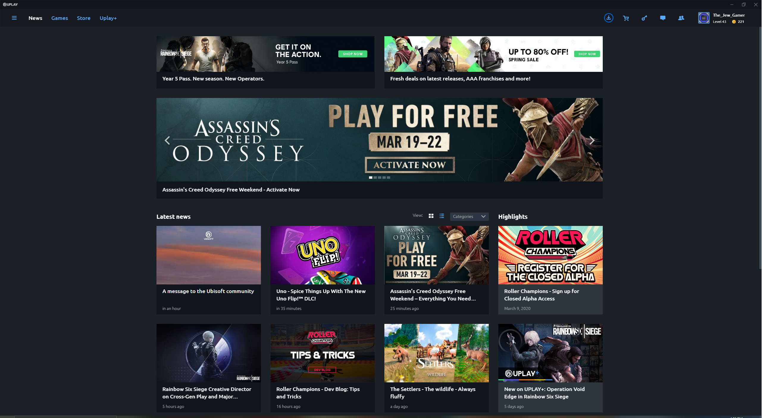
Uplay Interface

Slide 64

Class Objects
Accounts
Wish lists
Libraries
Friends
Listings
Coupons
Software
Downloads
Posts
Connections
Suggestions
Keys
Marketplaces
Categories
Mods
Functions
Buy Game
See Editions
View Friends
Send Friend Request
Accept Friend Request
View Settings
Change Account Info
Wish-list game
Download game
Play game
Login/Logout
https://www.epicgames.com/site/en-US/home

Slide 65
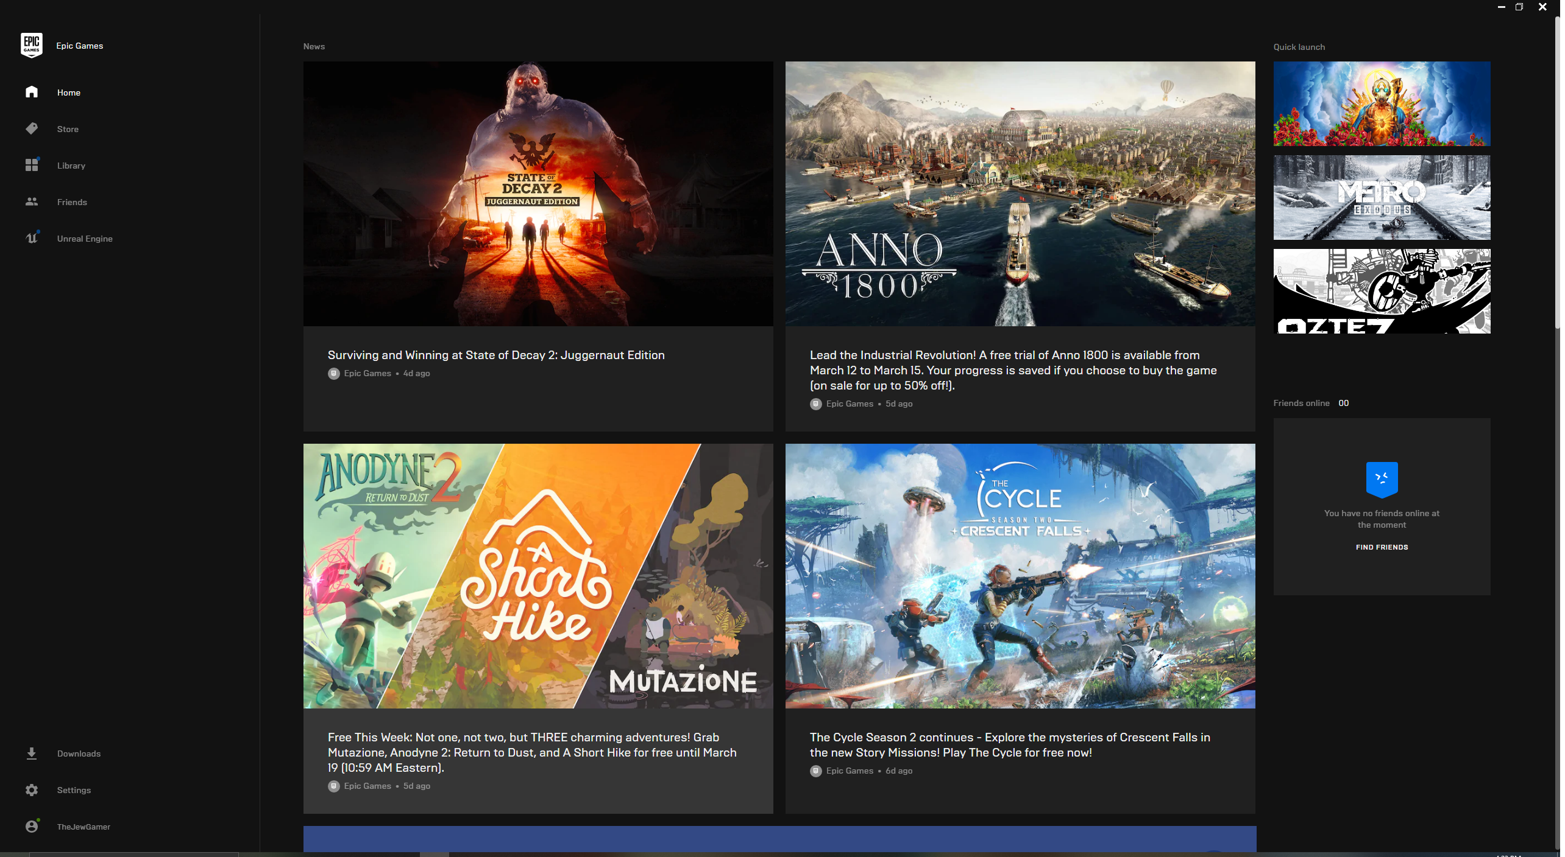
Epic Games Store Interface

Slide 66

Class Objects
Friends
Carts
Libraries
Software
Wish-lists
Activity/Notifications
Reviews
Forums
Chats
Wallets
Orders
Achievements
DLC
Listings
Accounts
Functions
Link Account
Login/Logout
Checkout
Add/remove from cart
Filter Library
Install/uninstall software
Write Review
Add/write to forum
Add/remove friend
Send Message
Search
https://www.gog.com/

Slide 67
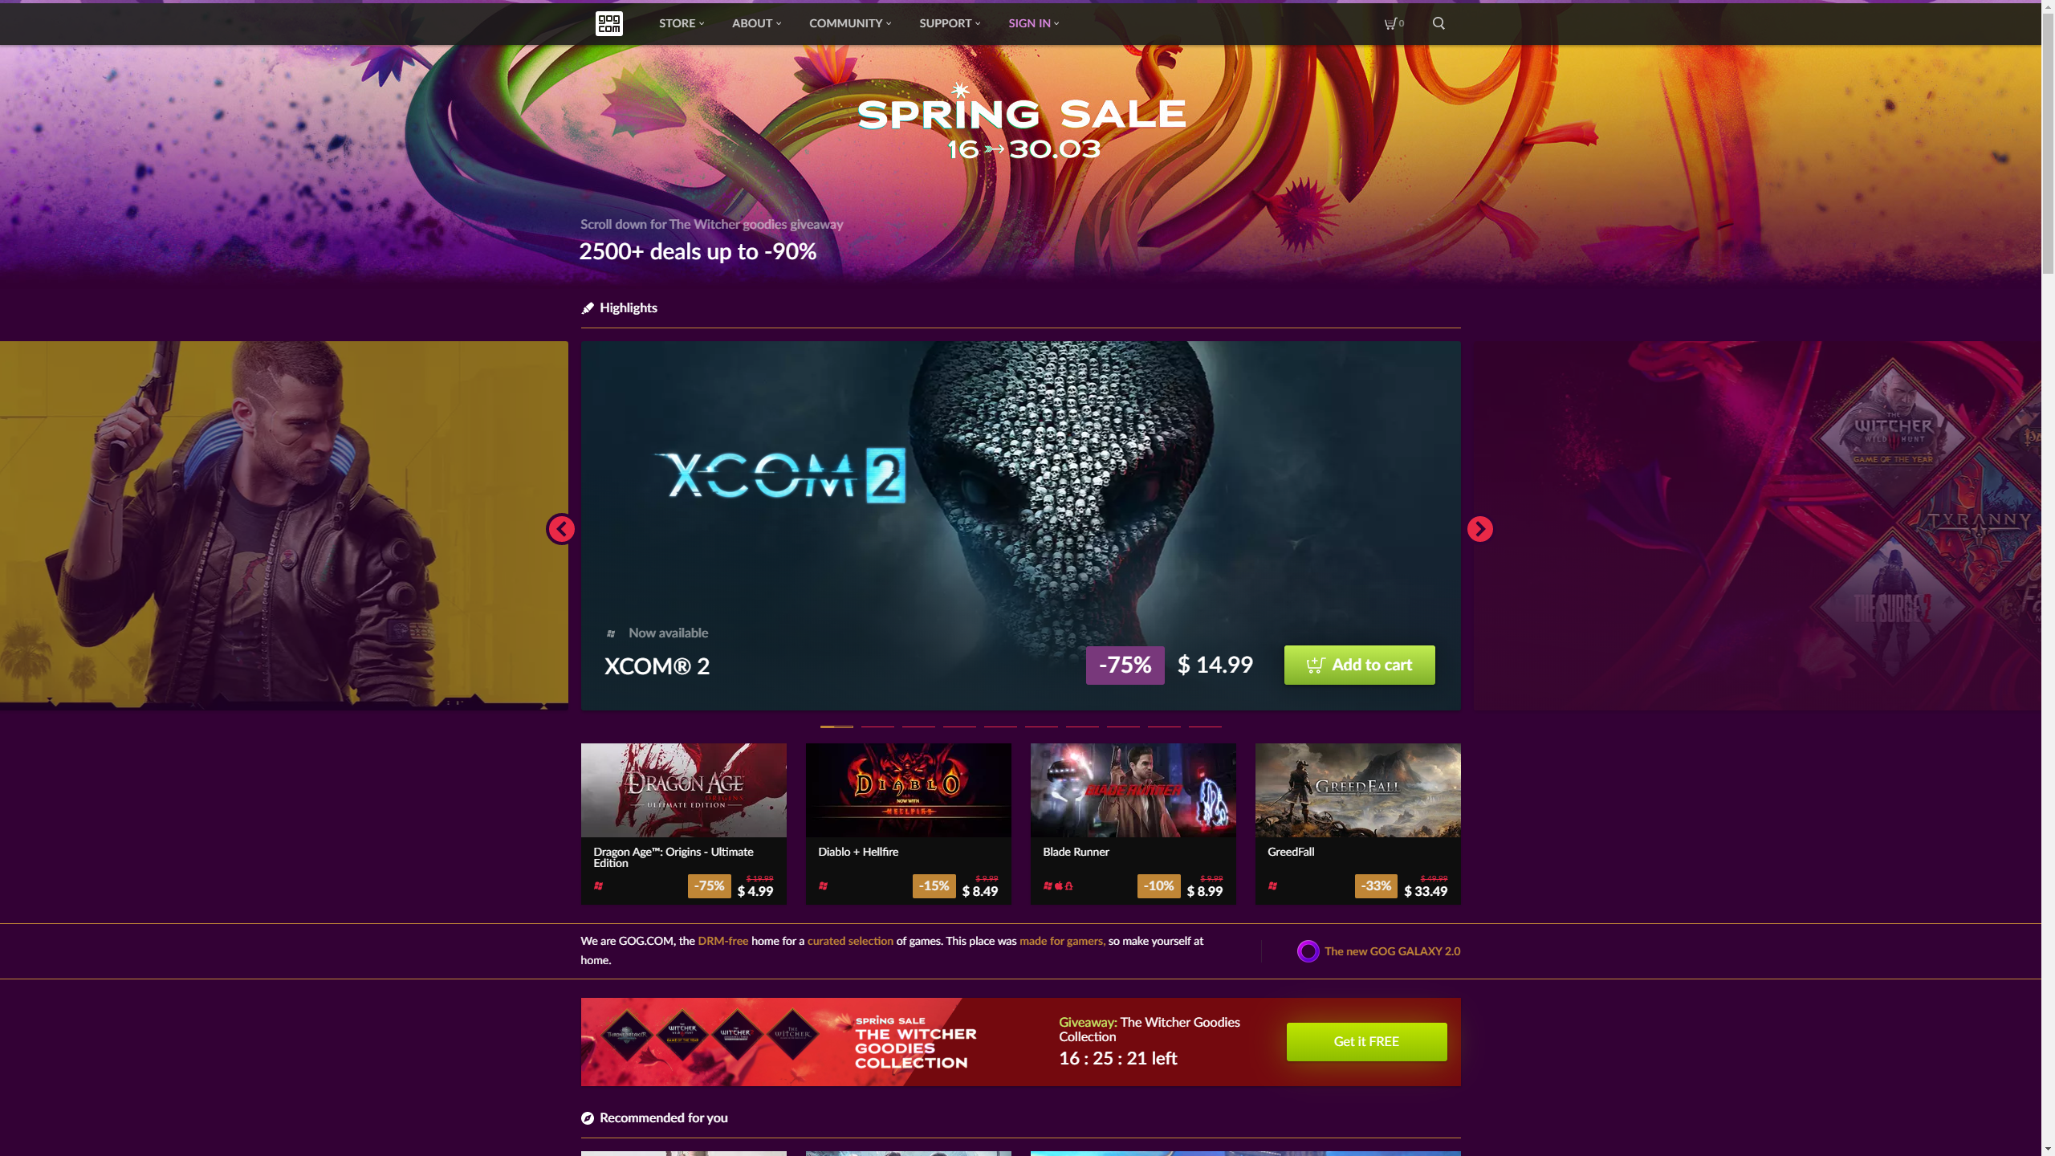
GOG Interface

Slide 68

Class Objects
Listings
Companies
Accounts
Coupons
Keys
Orders
Libraries
Wallets
Wish-lists
Charities
Subscriptions
Bundles
Carts
Posts
Rewards
Functions
Create Account
Login\Logout
Add to cart
Buy Game
View Game
Add Game to Wishlist
Add Funds top wallet
Purchase subscription
Change account info
Add listing
https://www.humblebundle.com/

Slide 69
Sources
https://www.statista.com/statistics/547025/steam-game-sales-revenue/
https://www.statista.com/statistics/831590/microsoft-quarterly-gaming-revenue/
https://www.statista.com/statistics/296226/annual-apple-app-store-revenue/
https://www.statista.com/statistics/444476/google-play-annual-revenue/
https://www.statista.com/statistics/269696/revenue-of-electronic-arts-since-2005/
https://www.statista.com/statistics/269664/blizzards-annual-revenue/
https://ubistatic19-a.akamaihd.net/comsite_common/en-US/images/53ddr%20va%20final_tcm99-352601_tcm99-196733-32.pdf
https://incfact.com/company/humblebundle-sanfrancisco-ca/
https://www.cdprojekt.com/en/wp-content/uploads-en/2019/03/fy2018-cd-projekt-group-results-presentation.pdf
https://www.epicgames.com/store/en-US/news/epic-games-store-weekly-free-games-in-2020

Slide 70
Appendix B: Detailed Project Estimates Sources
70

Slide 71
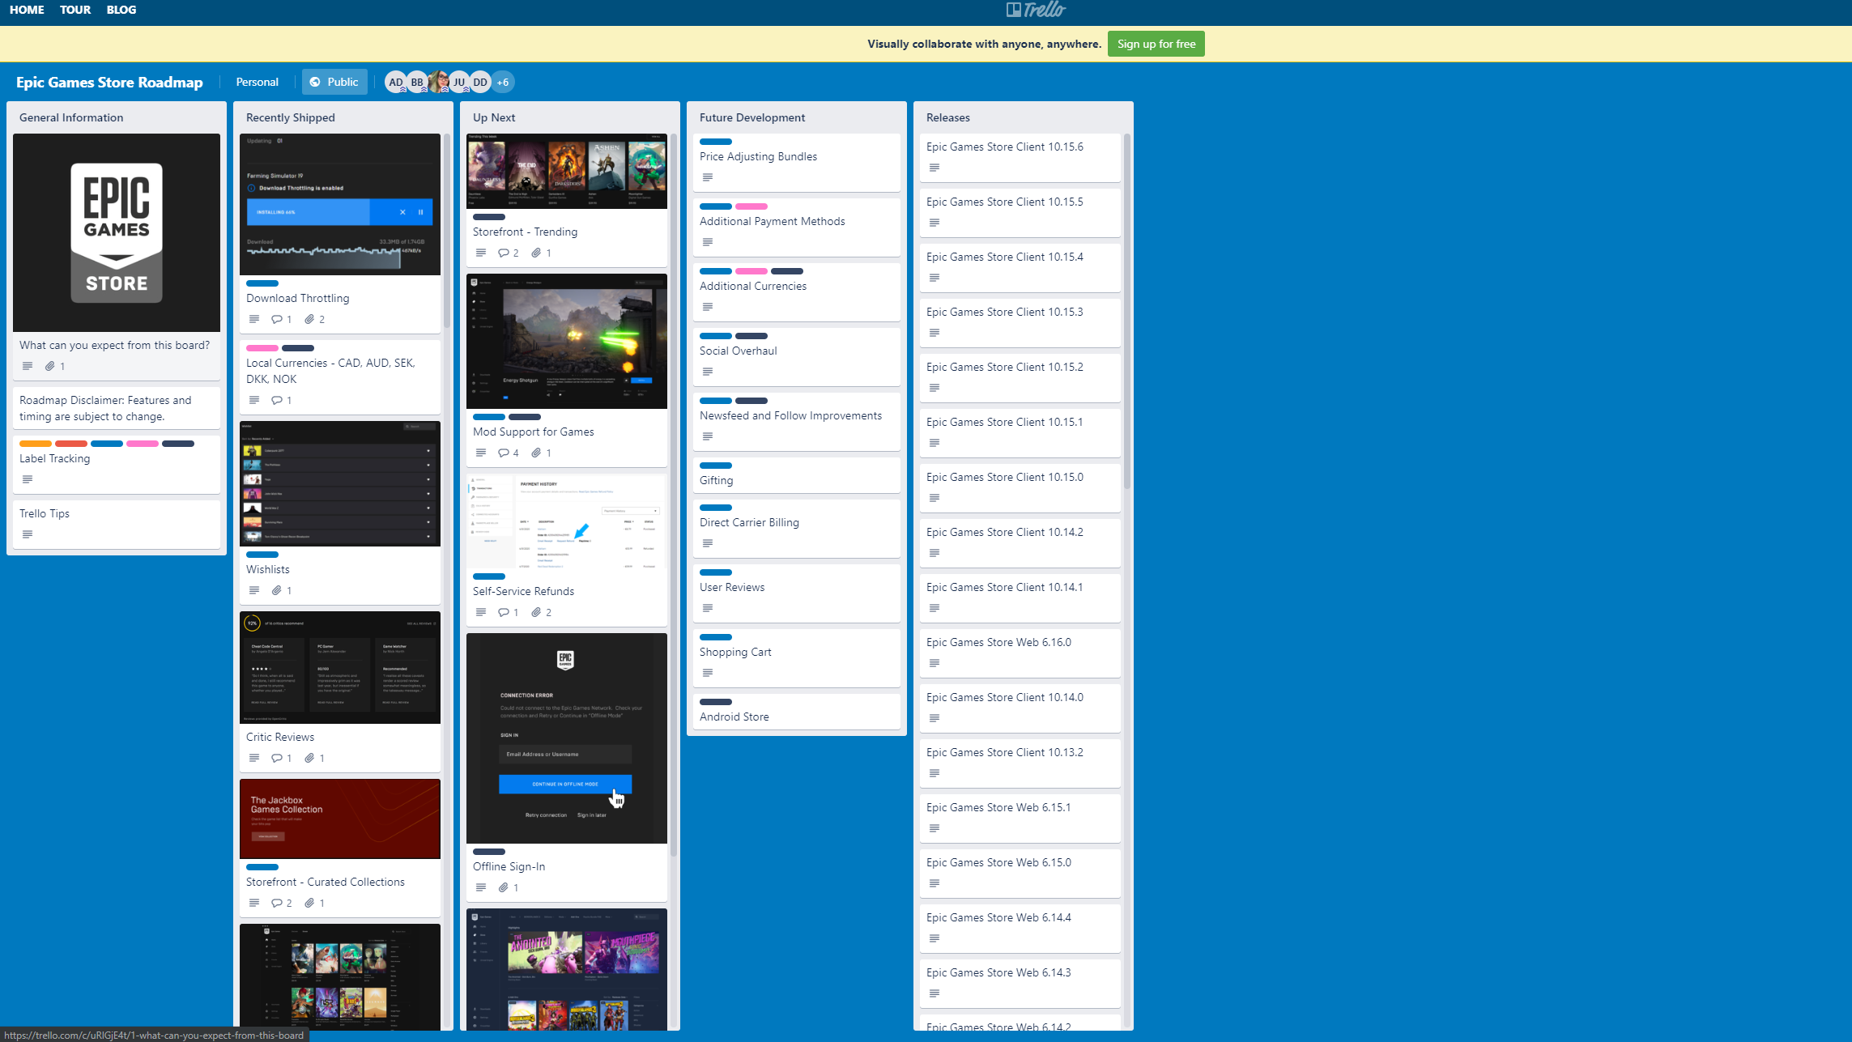
Epic Game Store Development plan

Slide 72
Sources
https://trello.com/b/GXLc34hk/epic-games-store-roadmap
https://successfulsoftware.net/2017/02/10/how-much-code-can-a-coder-code/

